Slide 1
Wireless for the Internet of Things IEEE 802.15.4 – Mesh and Low Power MAC
CS/ECE 4501
Spring 2024
UVA
[Pannuto, Ghena, Campbell]

Slide 2
Today’s Goals
Understand why IoT might want to use mesh networks
Describe one possible mesh network algorithm
Investigate a decade of low power MAC research

Slide 3
Outline
Mesh motivation
Mesh protocol (AODV)
Low power MAC

Slide 4
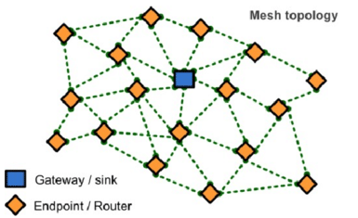
Enabling full mesh networks
All nodes:
Can send and receive data
Route and forward data in the network
Nodes connect with their neighbors
Gateway provides access to other networks/internet
We’re interested in meshes that
Use low power nodes (battery powered)
Are low data rate with small packets
802.15.4 provides foundation to build mesh on top
Contention Access Period

Slide 5
Mesh network layers
PHY Layer
802.15.4 physical layer
MAC Layer: 802.15.4
802.15.4 spec gives us the option of implementing our own
Technically this layer is here, but we generally ignore it
MAC Layer
Need to allow to TWO low power devices to communicate
Devices are off most (~99%) of the time
No assumption of energy asymmetry (as with PAN coordinator or BLE)
Network Layer: Mesh
Handles organizing the network
How should packets travel from nodes to the gateway?
How should packets travel from the gateway to nodes?
How should packets travel from node to node?
Network Layer Mesh Routing
MAC Layer Low Power
802.15.4 Contention MAC
PHY Layer O-QPSK - 2.4 GHz

Slide 6
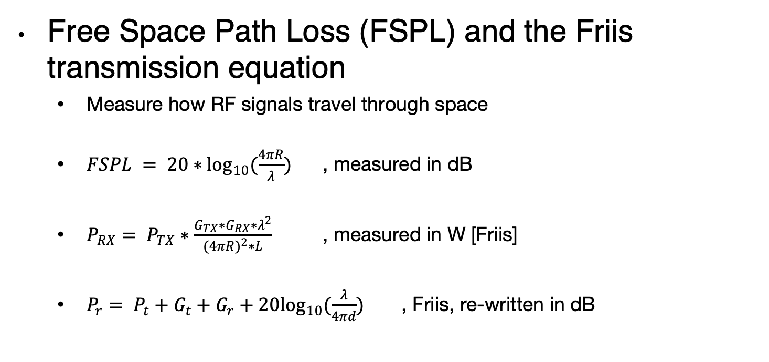
Quantitative intuition of “why bother meshing?”
Free Space Path Loss (FSPL) and the Friis transmission equation
Measure how RF signals travel through space
$FSPL = 20∗\log_{10}(\frac{4πR}{λ})$ , measured in dB
$P_{RX}= P_{TX}∗\frac{G_{TX}∗G_{RX}∗λ^{2}}{(4{πR)}^{2}∗L}$ , measured in W [Friis]
$P_{r}= P_{t}+G_{t}+G_{r}+20\log_{10}(\frac{λ}{4πd})$ , Friis, re-written in dB
Traditionally written as transmit distance
Image: https://www.sciencedirect.com/topics/computer-science/transmitting-antenna

Slide 7
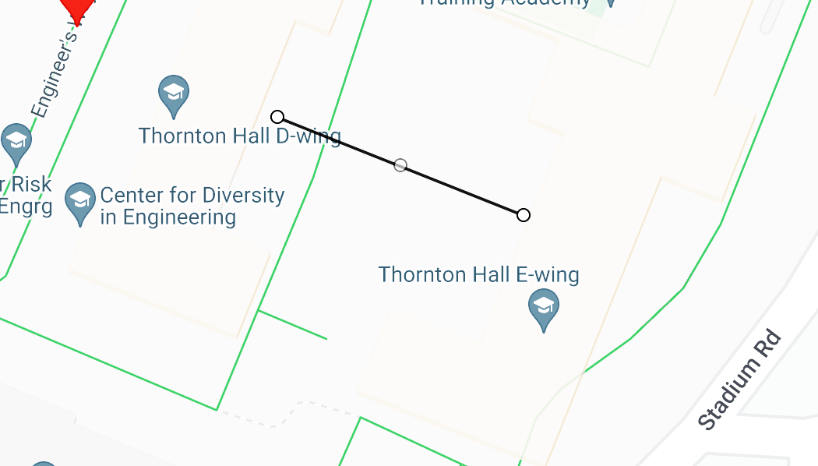

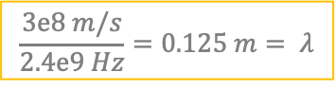

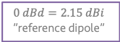
A hand-wavy quantitative analysis of “why bother meshing”?
D-wing to E-wing is ~40m wide; how to get from one side to the other?
$$\frac{3e8 m/s}{2.4e9 Hz}=0.125 m= λ$$
0 dBm
1 mW
$$20 ∗ \log_{10}\left(\frac{4π∗40}{0.125}\right)≈72 dB$$
-72 dBm (6.3e-8 mW)
-68 dBm (1.6e-7 mW)
$$0 dBm+2.15 dBi+2.15 dBi+20\log_{10}\left(\frac{0.125}{4π∗40}\right)≈68 dBm$$
$$0 dBd=2.15 dBi$$
”reference dipole”
$$20 ∗ \log_{10}\left(\frac{4π∗20}{0.125}\right)≈66 dB$$
$$__ dBm+2.15 dBi+2.15 dBi+20\log_{10}\left(\frac{0.125}{4π∗20}\right)≈68 dBm$$
Multi-hop mesh…
Reduces TX power
But adds RX, sync cost!
Improves aggregate network coverage
Can improve robustness
Reduces collision domain
-5.2 dBm
0.3 mW

Slide 8
Outline
Mesh motivation
Mesh protocol (AODV)
Low power MAC

Slide 9
Mesh Routing
Mesh topology makes routing question more complicated
Multiple hops in a route
Multiple routes between source and destination
Becomes a graph theory question based on cost metric
B
C
A
D
F
E

Slide 10
Reactive routing
Build up a map of the routes through a network
Hopefully the “optimal” routes
Map routes in reaction to a packet arrival
Sensor devices are slow and limited
Most likely to resend to same prior address
Discover a route when it is needed, then cache for next time
B
C
A
D
F
E
B Neighbor Table
A | c7:e3:45:00:1f:e4
C | c7:e3:45:ab:44:c6
D | 54:99:10:aa:b1:c3
B Forwarding Table
DST | Next Hop
F | C
A | A

Slide 11
Neighbor discovery
Which nodes are nearby to me?
i.e. within one packet transmission range
General Techniques
Periodically listen for nearby transmissions
Overhear packets
Source addresses indicate neighbors
Periodically send neighbor discovery probes
Announce your existence
Ask for neighbors to respond
Centrally collect neighbor information
Gateway disseminates to nodes as needed
B Neighbor Table
A | c7:e3:45:00:1f:e4
C | c7:e3:45:ab:44:c6
D | 54:99:10:aa:b1:c3
B
C
A
D
F
E

Slide 12
Ad-hoc On-demand Distance Vector Routing (AODV)
On-demand: Construct routes only when needed
Modern ZigBee routing approach (for Mesh topology)
Routing table
Destination node -> Next hop (for all cached destinations)
Store only next hop instead of full route
All routers along the path must also have Destination->Next mappings
Also keep hops-to-destination and last-seen-destination-sequence-number
Route discovery
Upon demand: check table
If not cached send Route Request (RREQ) via Flooding
Route is unknown, so flooding is needed

Slide 13
AODV Route Requests (RREQs)
Request ID | Source Address | Destination Address | Source SeqNo | Destination SeqNo | Hop Count
Request ID identifies this RREQ
Used to discard duplicates during flooding
Sequence Numbers are per-device, monotonically increasing
Used as a notion of “how recently” device has been seen
Source SeqNo is the source’s most recent sequence number
Destination SeqNo is the most recently seen from the destination by the source. (Defaults to zero)
Hop Count is the number of hops this request has taken
Starts at 1 and incremented by each transmitter along the path

Slide 14
Example AODV RREQ (A to F)
Request ID | Source Address | Destination Address | Source SeqNo | Destination SeqNo | Hop Count
A wants to find a route to F, so it sends out an RREQ
B
C
A
D
F
E

Slide 15
Example AODV RREQ (A to F)
Request ID | Source Address | Destination Address | Source SeqNo | Destination SeqNo | Hop Count
1 | A | F | 1 | 0 | 1
B and D also opportunistically add a routing table entry for A
B
C
A
D
F
E

Slide 16
Example AODV RREQ (A to F)
Request ID | Source Address | Destination Address | Source SeqNo | Destination SeqNo | Hop Count
1 | A | F | 1 | 0 | 2
B goes first via some access control protocol (D also in contention)
A and D ignore duplicate Request ID C opportunistically adds a routing table entry to A
B
C
A
D
F
E

Slide 17
Example AODV RREQ (A to F)
Request ID | Source Address | Destination Address | Source SeqNo | Destination SeqNo | Hop Count
1 | A | F | 1 | 0 | 2
D goes next by some access control protocol (C also in contention)
A, B, and C ignore duplicate Request ID E and F opportunistically adds a routing table entry to A
B
C
A
D
F
E

Slide 18
Example AODV RREQ (A to F)
Request ID | Source Address | Destination Address | Source SeqNo | Destination SeqNo | Hop Count
1 | A | F | 1 | 0 | 3
C and E repeat this process with Hop Count 3 (but everyone ignores them)
They go one-at-a-time, but I’m getting tired of drawing these
Actually, they’re in contention with the response from F
B
C
A
D
F
E

Slide 19
AODV Route Response (RREP)
Source Address | Destination Address | Destination SeqNo | Hop Count
Reply is sent unicast back to the source via newly constructed route
Each node along the way already knows the route back
Includes most recent destination sequence number as a sense of recency
No need for source sequence number anymore

Slide 20
Example AODV RREP (F to A)
Source Address | Destination Address | Destination SeqNo | Hop Count
F | A | 7 | 2
F sends response back to A via D
D opportunistically adds a routing table entry for F
B
C
A
D
F
E

Slide 21
Break + Practice
C wants to send a packet to E
What RREQ(s) are sent and what RREP(s) are sent?
B
C
A
D
F
E

Slide 22
Break + Practice
C wants to send a packet to E
What RREQ(s) are sent and what RREP(s) are sent?
RREQs:
C -> (B,D,F)
(B or D) -> A
(D or F) -> E
RREPs:
E -> (D or F) -> C
Network could have multiple configurations
B
C
A
D
F
E

Slide 23
Tradeoffs for reactive routing
Upside: no transmissions unless there is demand
Routes might appear, disappear, reappear, but no need to update if no one actually wants to transmit anything
Downside: large, variable delay when actually sending a packet
Full RREQ/RREP protocol before data can actually be sent
Route might have broken at some point
So data will be sent based on cached information
RERR will occur
RREQ/RREP will occur
Then data will be sent again

Slide 24
Reliability as a cost metric
Link quality can very from node to node
Fewest hops might not be the “fastest” or “most reliable” path
ETX: minimize “expected transmissions”
Measure link quality over time to determine each link’s reliability
B
C
A
D
F
E

Slide 25
Outline
Mesh motivation
Mesh protocol (AODV)
Low power MAC

Slide 26
Asynchronous MAC principles
Communication is possible if one device is receiving while other is transmitting
Both devices want to minimize the time they are receiving or transmitting (i.e. their radio is on) to reduce power draw
Devices can only coordinate using the data communication channel (i.e. no out-of-band communication)
No global synchronization mechanism
Goal: scheme to schedule TX and RX to permit communication while minimizing energy
Energy is paramount, but additional metrics:
Latency
Throughput
Reliability
Network scale
A
B

Slide 27


Slide 28

Early 2000s

Slide 29
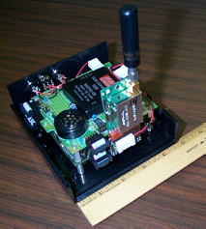
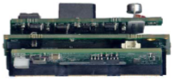
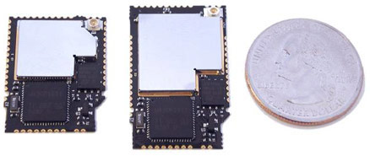
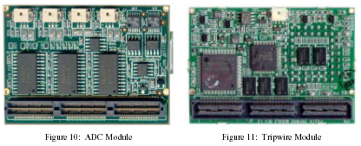
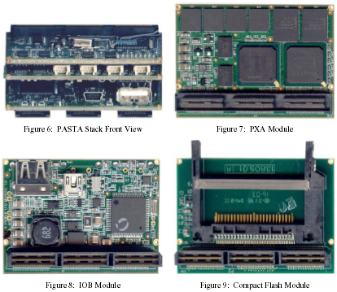
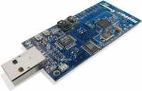
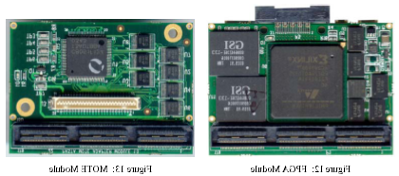
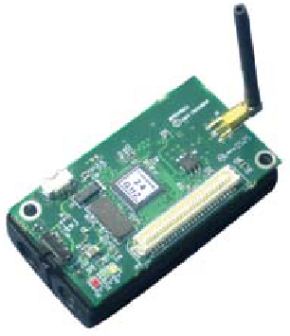
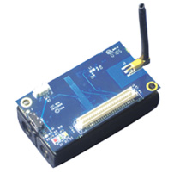
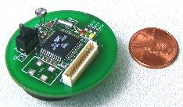
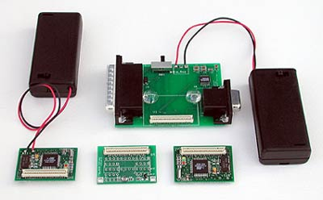
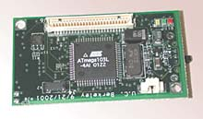
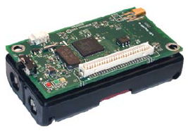
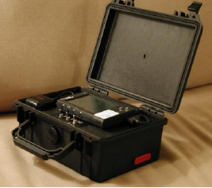
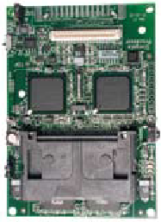
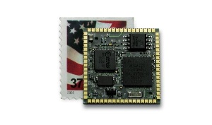
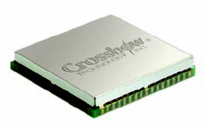
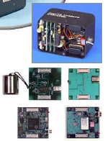
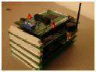
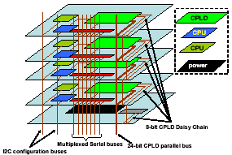
Early days of low power sensor nodes
Tmote Mini
[Sentilla07]
Telos/Tmote
[Polastre05]
PC/104 [Cerpa01]
PASTA [Bajura05]
Mica [Hill01]
Mica2 [Xbow03]
MicaZ [Xbow05]
Iris [Xbow07]
WeC [Hill98]
Rene [Hill99]
MicaZ Stamp
[Xbow06]
Iris OEM
[Xbow07]
WINSng [Pottie00]
Stargate [Intel]
WINS [Rockwell]
mPlatform[Lymberopoulos07]

Slide 30
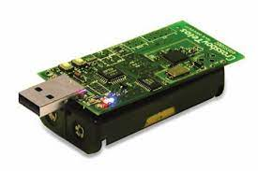
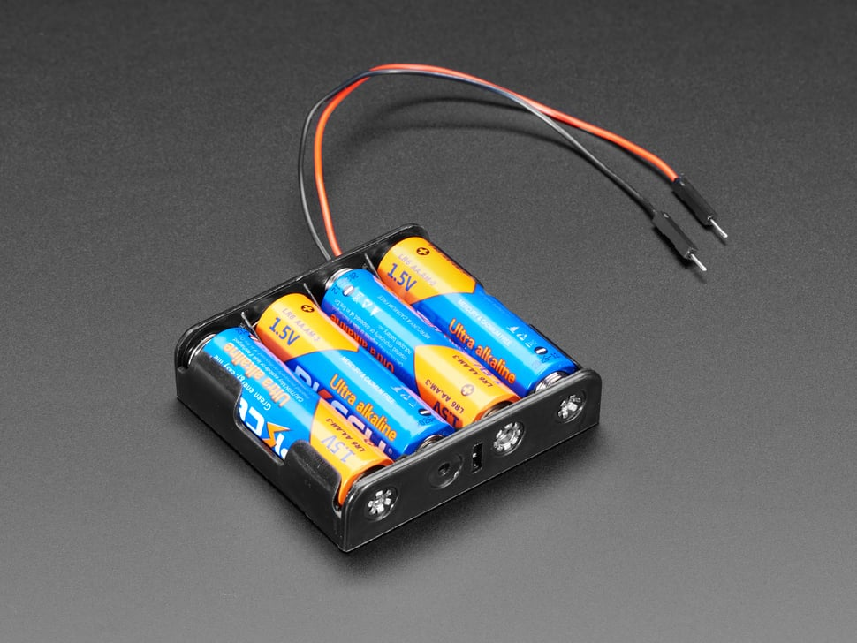
Low power: multiple year operation using batteries
P_{node} = P_{CPU} + P_{TX} + P_{RX} + P_{SLEEP}
E_{BATT} = P_{node} * lifetime
Lifetime ⬆️, P_{node}⬇️
P_{CPU} ≫ P_{SLEEP}
P_{TX} ≫ P_{SLEEP}
P_{RX} ≫ P_{SLEEP}
_{→ Minimize compute, TX, RX}
_{→ Maximize sleep}

Slide 31
Low power MAC principles
Communication is possible if one device is receiving while other is transmitting
Devices can only coordinate using the data communication channel (i.e. no out-of-band communication)
No global synchronization mechanism
Goal: scheme to schedule TX and RX to permit communication while minimizing energy
Energy is paramount, but additional metrics:
Latency
Throughput
Reliability
Network scale
A
B
Both devices want to minimize the time they are receiving or transmitting (i.e. their radio is on) to reduce power draw

Slide 32
Low Power Listening (LPL) - B-MAC (2004)
CCA
CCA
CCA
RX
TX ACK
CCA
Sleep
Sleep
Sleep
Sleep
Sleep
Receiver
Preamble
TX
RX ACK
Sleep
Sleep
Transmitter
Method:
Receiver periodically samples the channel
Transmitter sends a preamble long enough to ensure receiver will detect it
Upon detection, receiver stays awake to receive transmitted packet
Receiver ACKs if packet received correctly
Versatile Low Power Media Access for Wireless Sensor Networks. Joseph Polastre, Jason Hill and David Culler. SenSys 2004

Slide 33
LPL performance
CCA check interval
Too small: energy wasted on idle listening
Too large: energy wasted on transmissions (long preambles)
In general, it’s better to have larger preambles than to check more often!
Sensor sample period – controls the packet rate
Time between listening
(checking if the channel is idle)
Versatile Low Power Media Access for Wireless Sensor Networks. Joseph Polastre, Jason Hill and David Culler. SenSys 2004

Slide 34
LPL Drawback
A
CCA
CCA
CCA
RX
TX ACK
CCA
Sleep
Sleep
Sleep
Sleep
Sleep
Receiver
B
Preamble
TX
RX ACK
Sleep
Sleep
Transmitter
C
CCA
CCA
CCA
RX
DROP
CCA
Sleep
Sleep
Sleep
Sleep
Sleep
Receiver
Spend time listening to packets for someone else!
A
C
B
Versatile Low Power Media Access for Wireless Sensor Networks. Joseph Polastre, Jason Hill and David Culler. SenSys 2004

Slide 35
X-MAC: Shorter preambles and destination information
A
RX
RX
TX ACK
RX
TX ACK
RX
Sleep
Sleep
Sleep
Sleep
Receiver
B
TX (DST ID)
TX (DST ID)
TX (DST ID)
RX ACK
TX
RX ACK
Sleep
Sleep
Transmitter
Method
Transmitter sends a short “I have a packet for this address” packet
Nodes periodically listen, and ACK if the packet is for them
Upon receiving the ACK, the transmitter sends full packet
Receiver successfully receives the full packet.
X-MAC: A Short Preamble MAC Protocol for Duty-Cycled Wireless Sensor Networks. Michael Buettner, Gary V. Yee, Eric Anderson, Richard Han. SenSys 2006.

Slide 36
X-MAC: Overhearing node drops out early
A
RX
RX
TX ACK
RX
TX ACK
RX
Sleep
Sleep
Sleep
Sleep
Receiver
B
TX (DST ID)
TX (DST ID)
TX (DST ID)
RX ACK
TX
RX ACK
Sleep
Sleep
Transmitter
C
RX
RX
Sleep
Sleep
Sleep
Overhearer
X-MAC: A Short Preamble MAC Protocol for Duty-Cycled Wireless Sensor Networks. Michael Buettner, Gary V. Yee, Eric Anderson, Richard Han. SenSys 2006.

Slide 37
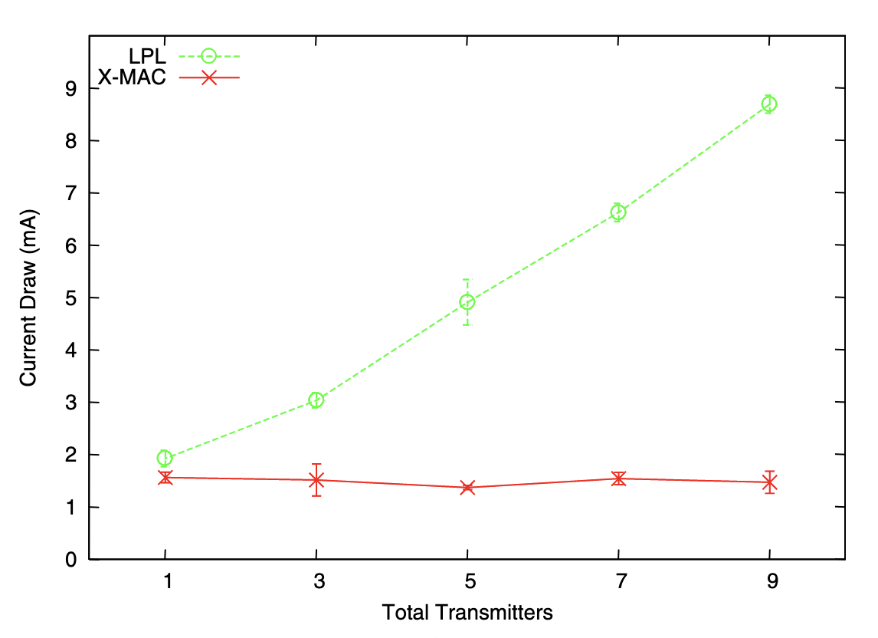
X-MAC: lower power draw than LPL with multiple nearby transmitters
X-MAC: A Short Preamble MAC Protocol for Duty-Cycled Wireless Sensor Networks. Michael Buettner, Gary V. Yee, Eric Anderson, Richard Han. SenSys 2006.

Slide 38
LPL (B-MAC) and X-MAC are transmitter initiated MAC protocols
Receiving nodes continuously periodically sample the wireless channel
When they detect a transmission they listen to receive packets
Transmitting nodes are only active when they want to transmit
Receiving nodes prone to unnecessary wakeups
Have to receive all nearby transmissions to see if the packet happens to be for them
Unnecessary wakeups lead to increasing receive energy → shorter lifetime
In general, difficult for receiver to know if it should stay awake or go back to sleep

Slide 39
Low Power Probing (LPP) is receiver initiated
A
TX Probe
RX
TX Probe
RX
TX ACK
TX Probe
RX
Sleep
Sleep
Sleep
Sleep
Receiver
B
RX
TX
RX ACK
Sleep
Sleep
Transmitter
Method
Receiver periodically transmits a probe, listens afterward
Transmitter listens for probe packet from intended recipient
Transmitter sends packet after receiving the correct probe packet
RI-MAC: A Receiver-Initiated Asynchronous Duty Cycle MAC Protocol for Dynamic Traffic Loads in Wireless Sensor Networks. Yanjun Sun, Omer Gurewitz, David B. Johnson. SenSys 2008.
Koala: Ultra-Low Power Data Retrieval in Wireless Sensor Networks. Razvan Musaloiu-E., Chieh-Jan Mike Liang, Andreas Terzis. IPSN 2008.

Slide 40
LPP introduces a new challenge for multiple nodes. What happens with multiple transmitters?
RX
TX
Sleep
Sleep
Transmitter
TX Probe
TX Probe
RX
TX Probe
Collision!!
Sleep
Sleep
Sleep
Sleep
Receiver
RX
TX
Sleep
Sleep
Transmitter
If multiple transmitters receive a probe, they both transmit, leading to a collision and a lost packet
Receiver is unsure if there actually was a packet, or just noise/interference on the channel
RI-MAC: A Receiver-Initiated Asynchronous Duty Cycle MAC Protocol for Dynamic Traffic Loads in Wireless Sensor Networks. Yanjun Sun, Omer Gurewitz, David B. Johnson. SenSys 2008.
Koala: Ultra-Low Power Data Retrieval in Wireless Sensor Networks. Razvan Musaloiu-E., Chieh-Jan Mike Liang, Andreas Terzis. IPSN 2008.

Slide 41
A-MAC resolves this with backcast constructive interference
RX
TX ACK
TX
RX
CCA
CCA
TX
RX ACK
Sleep
Sleep
Sleep
Transmitter
TX ACK
Listen
RX
TX Probe
TX Probe
RX ACK
RX
TX Probe
Listen
RX
TX Probe
TX ACK
Collision!!
Sleep
Sleep
Sleep
Receiver
RX
TX ACK
TX
RX
CCA
TX
RX ACK
Sleep
Sleep
Transmitter
Method
Transmitters send an ACK in response to a probe packet
With multiple transmitters, the ACKs collide, but interfere non-destructively, so the receiver still receives an ACK
The receiver stays awake to receive a packet, but the packet collides
The receiver sends a new probe, informing transmitters there was a collision
Transmitters use CSMA/CA to send packets
Design and Evaluation of a Versatile and Efficient Receiver-Initiated Link Layer for Low-Power Wireless. Prabal Dutta, Stephen Dawson-Haggerty, Yin Chen, Chieh-Jan Mike Liang, and Andreas Terzis. SenSys 2010.

Slide 42
Summary: asynchronous low power MAC protocols
Transmitter initiated protocols
Receivers periodically sample the channel
Transmitters transmit sufficiently to ensure recipients heard
Examples: LPL, X-MAC
Pros:
Simple, intuitive
Can balance TX and RX energy with sample interval
Cons:
Receivers prone to false wake-ups
High idle listening energy costs
Receiver initiated protocols
Receivers periodically transmit probes
Transmitters listen for a probe before sending a packet
Examples: RI-MAC, Koala, A-MAC
Pros:
Fixed, small listening energy cost for receivers
Cons:
Multiple transmitters leads to collisions

Slide 43
Mesh network layers
PHY Layer
802.15.4 physical layer
MAC Layer: 802.15.4
802.15.4 spec gives us the option of implementing our own
Technically this layer is here, but we generally ignore it
MAC Layer
Need to allow to TWO low power devices to communicate
Devices are off most (~99%) of the time
No assumption of energy asymmetry (as with PAN coordinator or BLE)
Network Layer: Mesh
Handles organizing the network
How should packets travel from nodes to the gateway?
How should packets travel from the gateway to nodes?
How should packets travel from node to node?
Network Layer Mesh Routing
MAC Layer Low Power
802.15.4 Contention MAC
PHY Layer O-QPSK - 2.4 GHz

